Slide 1
Preliminaries
Mathematical Preliminaries
Strings and Languages

Slide 2
Mathematical Preliminaries

Slide 3
Mathematical Preliminaries
Sets
Functions
Relations
Graphs
Proof Techniques

Slide 4
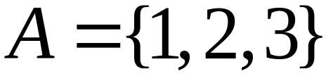

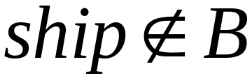
SETS
A set is a collection of elements
We write

Slide 5
Set Representations
  C = { a, b, c, d, e, f, g, h, i, j, k }
  C = { a, b, …, k }
  S = { 2, 4, 6, … }
  S = { j : j > 0, and j = 2k for k>0 }
  S = { j : j is nonnegative and even }
finite set
infinite set

Slide 6
A = { 1, 2, 3, 4, 5 }
U
6
A
2
8
1
3
7
4
5
9
10
Universal Set: all possible elements
    U = { 1 , … , 10 }

Slide 7
Set Operations
A = { 1, 2, 3 } B = { 2, 3, 4, 5}
Union
A U B = { 1, 2, 3, 4, 5 }
Intersection
    A B = { 2, 3 }
Difference
    A - B = { 1 }
    B - A = { 4, 5 }
A
B
2
4
1
3
5
U
2
3
1

Slide 8
Complement
      Universal set = {1, …, 7}
      A = { 1, 2, 3 } A = { 4, 5, 6, 7}
4
A
A
6
1
3
2
5
7
A = A

Slide 9
{ even integers } = { odd integers }
Integers
1
odd
0
5
even
2
6
4
3
7

Slide 10
DeMorgan’s Laws
A U B = A B
U
A B = A U B
U

Slide 11
Empty, Null Set:
= { }
S U = S
S =
S - = S
- S =
U
= Universal Set

Slide 12
Subset
A = { 1, 2, 3} B = { 1, 2, 3, 4, 5 }
U
A B
Proper Subset:
U
A B
B
A

Slide 13
Disjoint Sets
A = { 1, 2, 3 } B = { 5, 6}
A B =
U
A
B

Slide 14
Set Cardinality
For finite sets
A = { 2, 5, 7 }
|A| = 3
(set size)

Slide 15
Powersets
A powerset is a set of sets
S = { a, b, c }
Powerset of S = the set of all the subsets of S， P（S），2^{S}
2^{S} = { , {a}, {b}, {c}, {a, b}, {a, c}, {b, c}, {a, b, c} }
Observation: | 2^{S} | = 2^{|S|} ( 8 = 2³ )

Slide 16
Cartesian Product
A = { 2, 4 } B = { 2, 3, 5 }
A X B = { (2, 2), (2, 3), (2, 5), ( 4, 2), (4, 3), (4, 5) }
|A X B| = |A|*|B|
Generalizes to more than two sets
A X B X … X Z

Slide 17
Examples:
  What is: {1, 2 , 3} × {a,b} =
  True or false: {(1,a), (3,b)} ⊆ {1, 2 , 3} × {a,b}
  True or false: {1,2,3} ⊆ {1, 2 , 3} × {a,b}
{(1,a), (1,b), (2,a), (2,b), (3,a), (3,b)}
true
false

Slide 18
FUNCTIONS
Given two sets A and B, a function from A into B
associates with each a in A at most one element b of B
domain
range
4
A
B
f(1) = a
1
a
2
b
3
c
5
f : A -> B

Slide 19
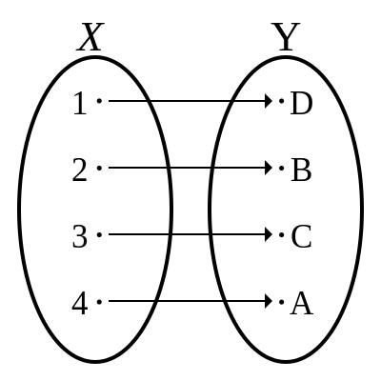
f : A -> B
If A = domain
then f is a total function
otherwise f is a partial function
f : A -> B is a bijection
  f is total
  for all a and a’ in A, a!=a’ implies f(a)!=f(a’)
  for all b in B, there is a in A with f(a)=b

Slide 20
Big O Notation
Given two total function f,g:N->N,
  we write f(n)=O(g(n)), if there are positive integers c and d such that, for all n≥ d, f(n) ≤cg(n);
  we write f(n)=Ω (g(n)), if there are positive integers c and d such that, for all n≥ d, cf(n) ≥ g(n).
If f(n)=O(g(n)) and f(n)=Ω (g(n)), then we write f(n)=θ(g(n)).
Whenever f(n)=O(g(n)), then g(n) is an upper bound for f(n) and whenever f(n)=Ω (g(n)), g(n) is a lower bound for f(n).
The big-O notation compares the rate of growth of functions rather than their values, so when f(n)=θ (g(n)), f(n) and g(n) have the same rates of growth, but can be very different in their values.
f(n)=Ω (g(n)) <=> g(n)=O(f(n))

Slide 21
Example
f(n) = 2n² + 3n
g(n) = n³
h(n) = 10 n² + 100
f(n) = O(g(n))
g(n) = Ω(h(n))
f(n) = Θ(h(n))

Slide 22
RELATIONS
An n-ary relation R, n≥1, with respect to sets A_1,A_2,…,A_n is any subset R of A_1 X A_2 X … X A_n.
Given two sets, A and B, a relation R is any subset of A × B. In other words, R ⊆ A × B
R = {(x₁, y₁), (x₂, y₂), (x₃, y₃), …}
x_{i} R y_{i}
e. g. if R = ‘>’: 2 > 1, 3 > 2, 3 > 1

Slide 23
Equivalence Relations
Reflexive: x R x
Symmetric: x R y y R x
Transitive: x R y and y R z x R z
Example: R = ‘=‘
x = x
x = y y = x
x = y and y = z x = z

Slide 24
Equivalence Classes
For an equivalence relation R, we define equivalence class of x
[x]_{R} = {y : x R y}
Example:
R = { (1, 1), (2, 2), (1, 2), (2, 1),
(3, 3), (4, 4), (3, 4), (4, 3) }
Equivalence class of [1]_{R} = {1, 2}
Equivalence class of [3]_{R} = {3, 4}

Slide 25
Set of Natural numbers is partitioned by “mod 5” relation into five “equivalence classes”:
  { {0,5,10,…}, {1,6,11,…}, {2,7,12,…}, {3,8,13,…}, {4,9,14,…} }
“String length” can be used to partition the set of all bit strings.
  { {},{0,1},{00,01,10,11},{000,…,111},… }

Slide 26
Let R be an equivalence relation over A. Then for all a,b in A, either [a]_{R}=[b]_{R} or [a]_{R} [b]_{R}=
A binary relation R over A is a partial order if it is reflexive, transitive, and antisymmetric.
A binary relation R over A is a total order if it is a partial order and for all a,b in A, either aRb or bRa.
A total order is often called a linear order because the elements of A can be laid out on a straight line such that a is to the left of b if and only if aRb.
U

Slide 27
GRAPHS
A directed graph G=〈V, E〉
e
b
node
a
d
edge
c
Nodes (Vertices)
V = { a, b, c, d, e }
Edges
E = { (a,b), (b,c), (b,e),(c,a), (c,e), (d,c), (e,b), (e,d) }

Slide 28
Labeled Graph
2
6
e
2
b
1
3
a
d
6
5
c

Slide 29
Walk
e
b
a
d
c
Walk is a sequence of adjacent edges
(e, d), (d, c), (c, a)

Slide 30
Path
e
b
a
d
c
A path is a walk where no edge is repeated
A simple path is a path where no node is repeated
Notes:
Not simple e d c e b c a

Slide 31
Cycle
e
base
b
3
1
d
a
2
c
A cycle is a walk from a node (base) to itself
A simple cycle: only the base node is repeated
Notes:
Not simple b c e b c a b

Slide 32
Given a directed graph G=(V,E) and nodes u and v, we say v is reachable from u, or u-reachable, if there is a path from u to v.
Algorithm Reachability.
On entry: A digraph G=(V,E) and a node u in V.
On exit: The set R of all u-reachable nodes in G.
begin R:={u}; N:={u};
repeat T:= ;
for all v in N do T:=T U {w: (v,w is in E};
N:=T-R; //The new u-reachable nodes}
R:=R U N
until N= ;
end

Slide 33
Trees
root
parent
leaf
child
A tree is a directed graph that has no cycle.

Slide 34
root
Level 0
Level 1
leaf
Height 3
Level 2
Level 3

Slide 35
PROOF TECHNIQUES
Proof by induction
Proof by contradiction

Slide 36
Induction
We have statements P₁, P₂, P₃, …
If we know
    for some b that P₁, P₂, …, P_{b} are true
    for any k >= b that
        P₁, P₂, …, P_{k} imply P_{k+1}
Then
Every P_{i} is true, that is, ∀i P(i)

Slide 37
Proof by Contradiction
We want to prove that a statement P is true
    we assume that P is false
    then we arrive at an incorrect conclusion
    therefore, statement P must be true

Slide 38
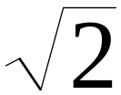
Example
Theorem: is not rational
Proof:
    Assume by contradiction that it is rational
    = n/m
    n and m have no common factors
    We will show that this is impossible

Slide 39
= n/m 2 m² = n²
n is even
n = 2 k
Therefore, n² is even
m is even
m = 2 p
2 m² = 4k²
m² = 2k²
Thus, m and n have common factor 2
Contradiction!

Slide 40

Pigeon Hole Principle:
If n+1 objects are put into n boxes, then at least
one box must contain 2 or more objects.

Slide 41
Ex: Can show if 5 points are placed inside a square whose sides are 2 cm long ➔ at least one pair of points are at a distance ≤ √2 cm.
According to the PHP, if we divide the square into 4, at least two of the points must be in one of these 4 squares. But the length of the diagonals of these squares is √2.
➔ the two points cannot be further apart than √2 cm.

Slide 42
Languages

Slide 43
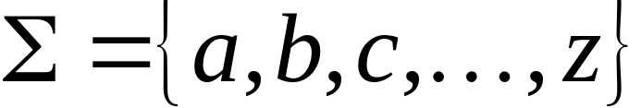
A language is a set of strings
String: A sequence of letters/symbols
  Examples: “cat”, “dog”, “house”, …
  Symbols are defined over an alphabet:

Slide 44

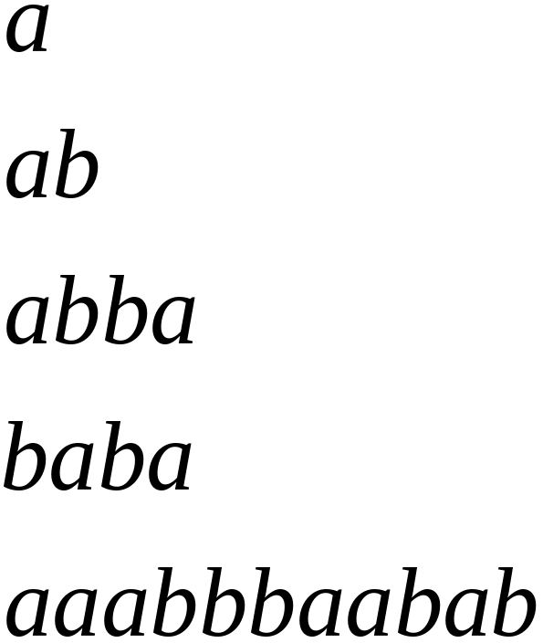
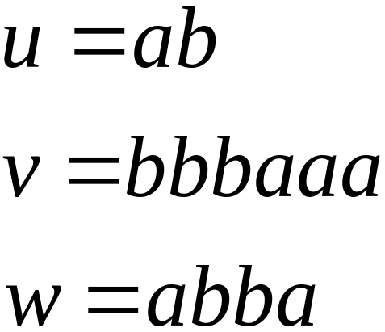
Alphabets and Strings
We will use small alphabets:
Strings

Slide 45
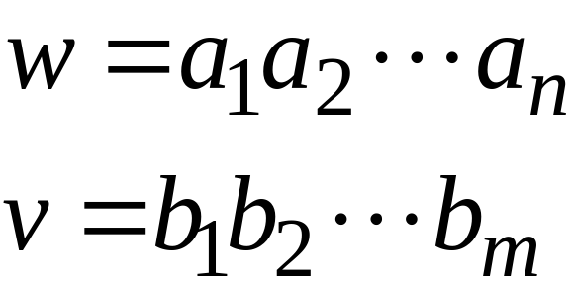
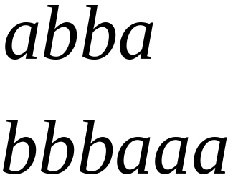
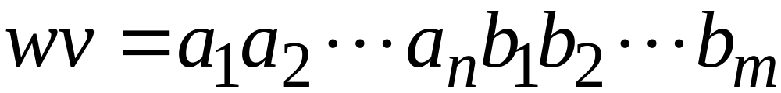

String Operations
Concatenation

Slide 46




Reverse

Slide 47


String Length
Length: The length of a string x is the number of symbols contained in the string x, denoted by |x|.
Examples:

Slide 48


Length of Concatenation
Example:

Slide 49
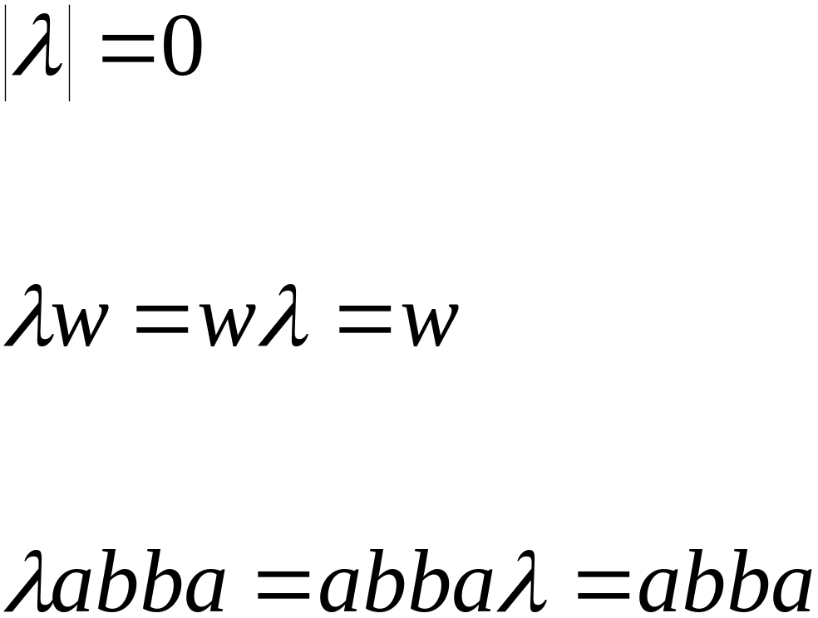
The Empty String
A string with no letters: λ，（ε）
Observations:

Slide 50


Substring
Substring of string:
  a subsequence of consecutive characters
  s is a substring of x if there exist strings y and z such that x = ysz.
  String Substring

Slide 51




Prefix and Suffix （x＝ysz）
when x = sz (y=ε), s is called a prefix of x;
when x = ys (z=ε), s is called a suffix of x.
Prefixes Suffixes
prefix
suffix

Slide 52




Another Operation
Example:
Definition:

Slide 53
Solve equation 011x=x011
If x=λ, then ok.
If |x|=1, then no solution.
If |x|=2, then no solution.
If |x|>3, then x=011y. Hence,
011x=011y011. So, x=y011.
Hence, 011y=y011.
x=(011) for k > 0
k

Slide 54



The * Operation
: the set of all possible strings from alphabet

Slide 55



The + Operation
: the set of all possible strings from
alphabet except

Slide 56


Languages
A language is a set of strings，is any subset of
Example:
Languages:

Slide 57




Note that:
Sets
Set size
Set size
String length

Slide 58




Another Example
An infinite language

Slide 59


Operations on Languages
The usual set operations
Complement:

Slide 60

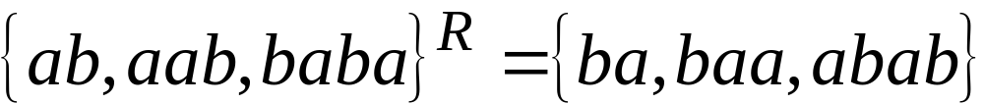

Reverse
Definition:
Examples:

Slide 61


Concatenation
Definition:
Example:

Slide 62



Another Operation
Definition:
Special case:

Slide 63



More Examples

Slide 64


Star-Closure (Kleene *)
Definition:
Example:

Slide 65
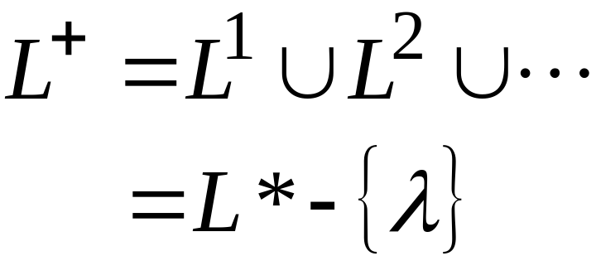

Positive Closure
Definition:

